Slide 1

Relaxing model assumptions
Implementing heterogeneities

Slide 2
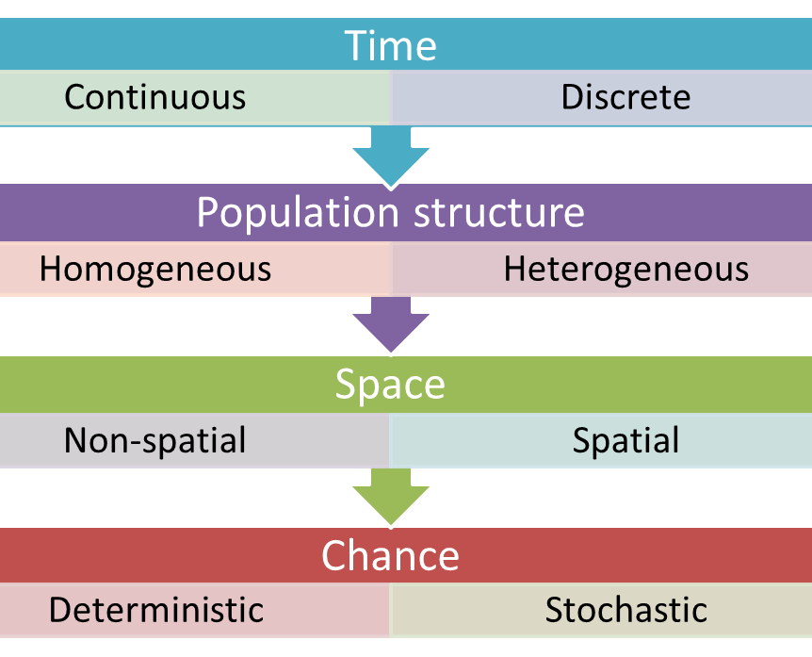
Types of mathematical models

Slide 3
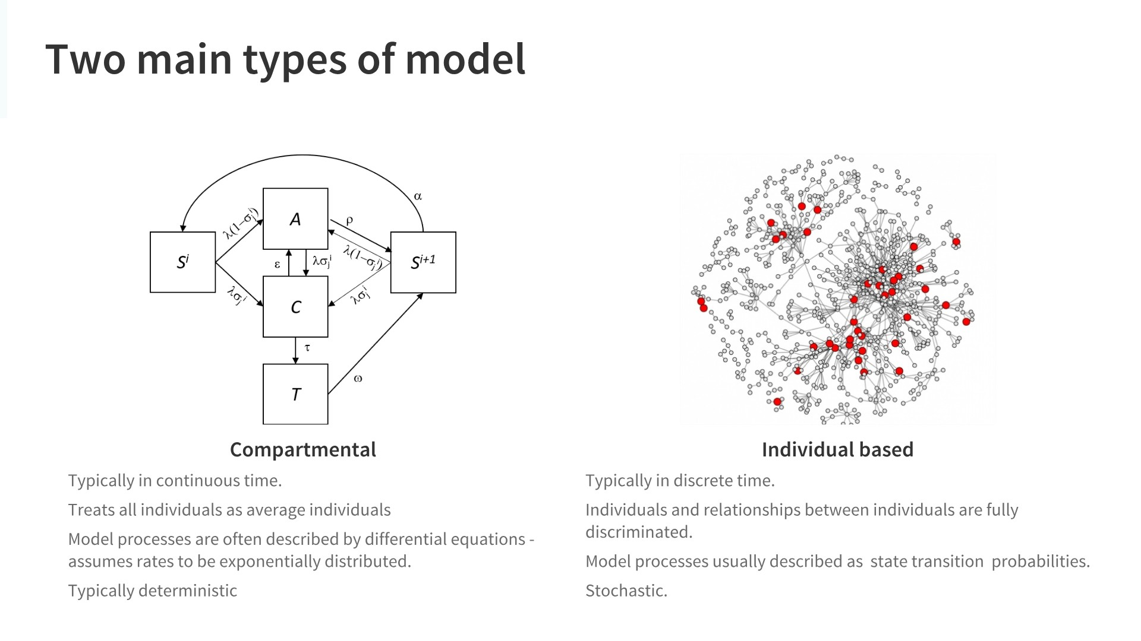

Slide 4
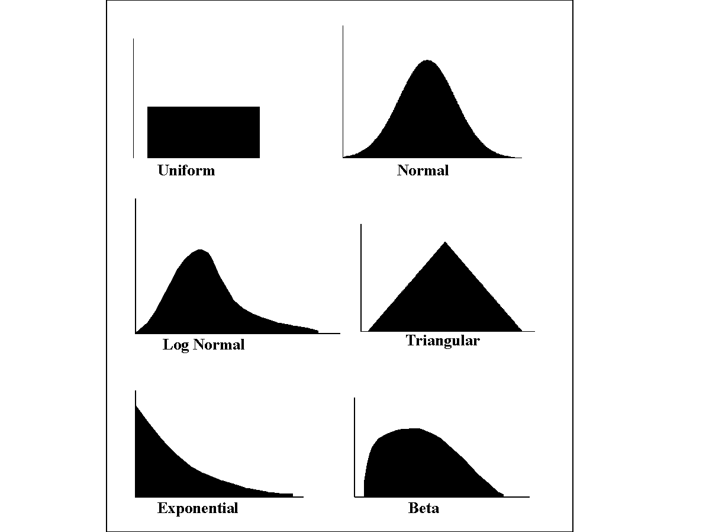
Deterministic
Randomness is missing. Output is fully determined by the parameter values and the initial conditions.
Stochastic
Models possess some inherent randomness. Stochastic = randomly determined.
Demographic stochasticity has a large impact on small populations.
Typically, only valid for large populations. Not appropriate for elimination timeline estimates.
x1
x1
x2
x3
Model
y
x2
Model
y
x3

Slide 5
Deterministic vs stochastic models
N_{t+1}=λ(t)N_{t}
What is the expected population size at time t=100 if λ=1 for all t given N₀=1000?
What if λ is a binary variable such that:

Slide 8
How?
Say that you draw the following sequence for λ values:
1.1 ; 0.9 ; 0.9 ; 0.9 ; 1.1 ; 1.1.
Say that the initial population size is 1000. Calculate the population size at time 6 given the above values for λ.
N(6)=1000*1.1*0.9*0.9*0.9*1.1*1.1
970!

Slide 9
Factors Influencing Disease Transmission
Host
Age
Pathogen
Infectivity
Environment
Weather
Pathogenicity
Virulence
Immunogenicity
Antigenic stability
Survival
Gender
Genotype
Behaviour
Nutritional status
Health status
Housing
Geography
Occupational setting
Air quality
Mosquito density
Genotype

Slide 10
Epidemiology triad
Host
Pathogen
Environment
Demographics
Socioeconomic status
Life cycle
Genetics
Physical
Social
Biological
Disease

Slide 11
Malaria risk factors in the GMS
Age
Gender
Residence (distance to forest)
Occupation
Travel

Slide 12
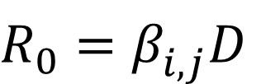
General SEIR model
S
I
R
E
Adding age classes
S1
I1
R1
E1
S2
I2
R2
E2
Sn
In
Rn
En
$R_{0}=β_{i,j}^{}D$

Slide 13
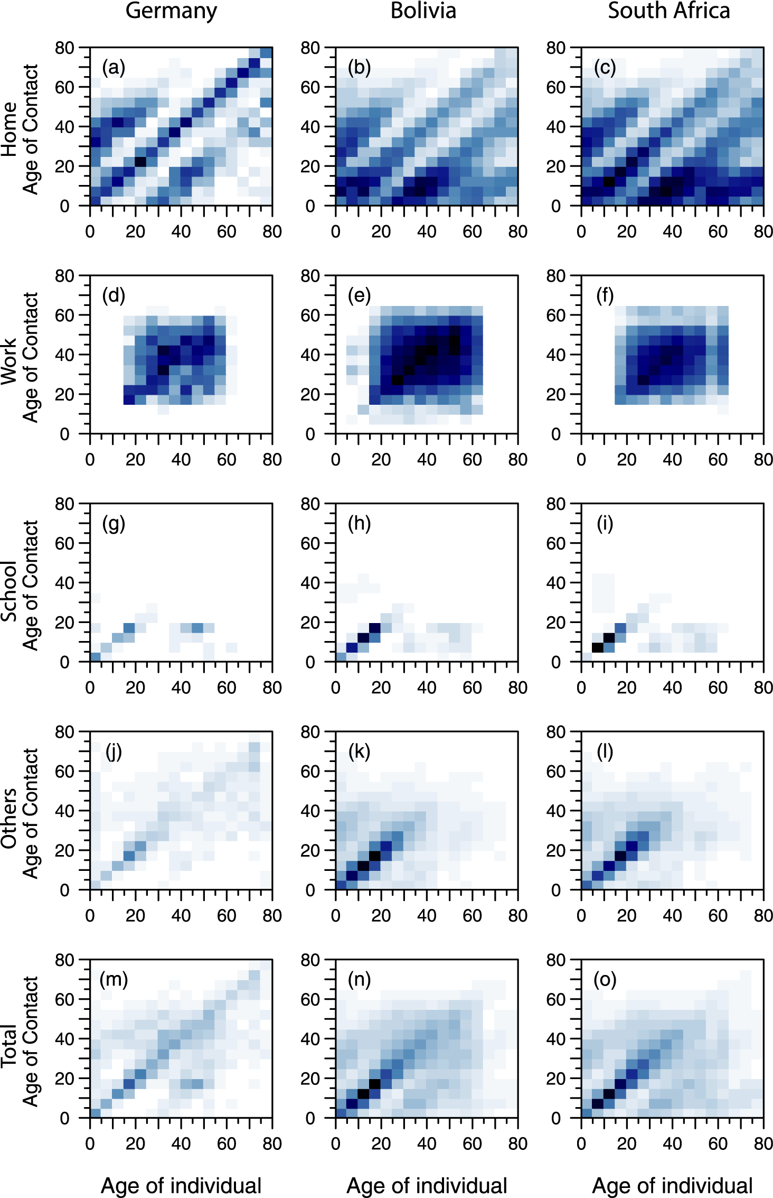
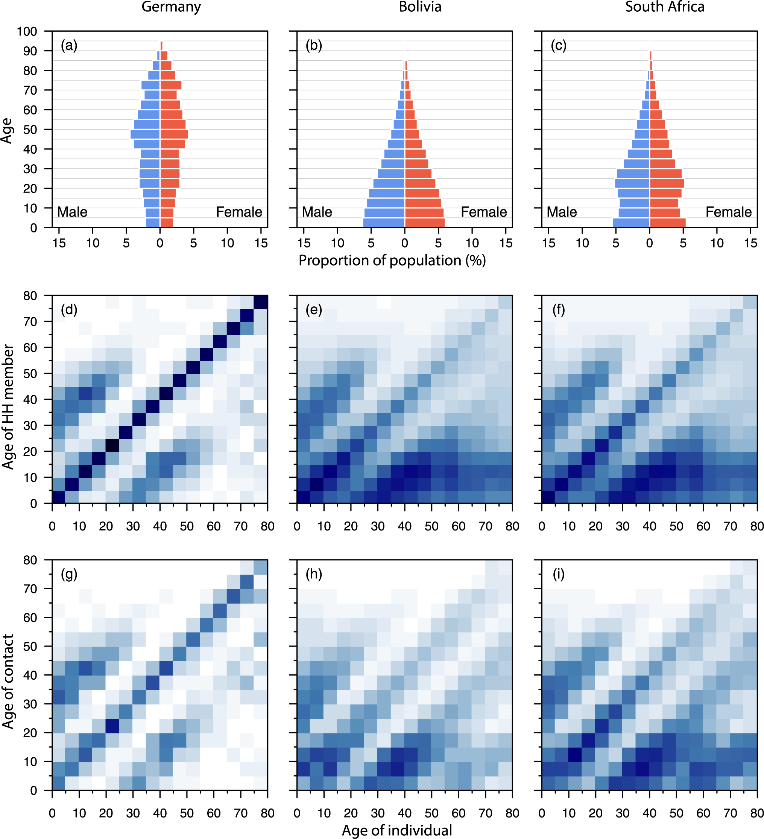
WAIFW contact Matrices

Slide 14
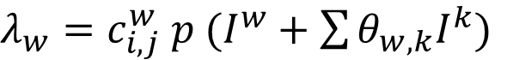
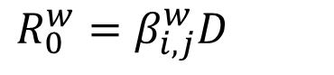
Adding place of residence
PLACE A
PLACE B
S1A
E1A
I1A
R1A
S1B
E1B
I1B
R1B
S2A
E2A
I2A
R2A
S2B
E2B
I2B
R2B
SnA
EnA
InA
RnA
SnB
EnB
InB
RnB
$R_{0}^{w}=β_{i,j}^{w}D$
$λ_{w}=c_{i,j}^{w} p (I^{w}+\sum{θ_{w,k}I^{k}})$

Slide 15
Adding place of residence
S1A
E1A
I1A
R1A
S2A
E2A
I2A
R2A
Z
A
C
D
E
F
G
H
B
SnA
EnA
InA
RnA

Slide 16
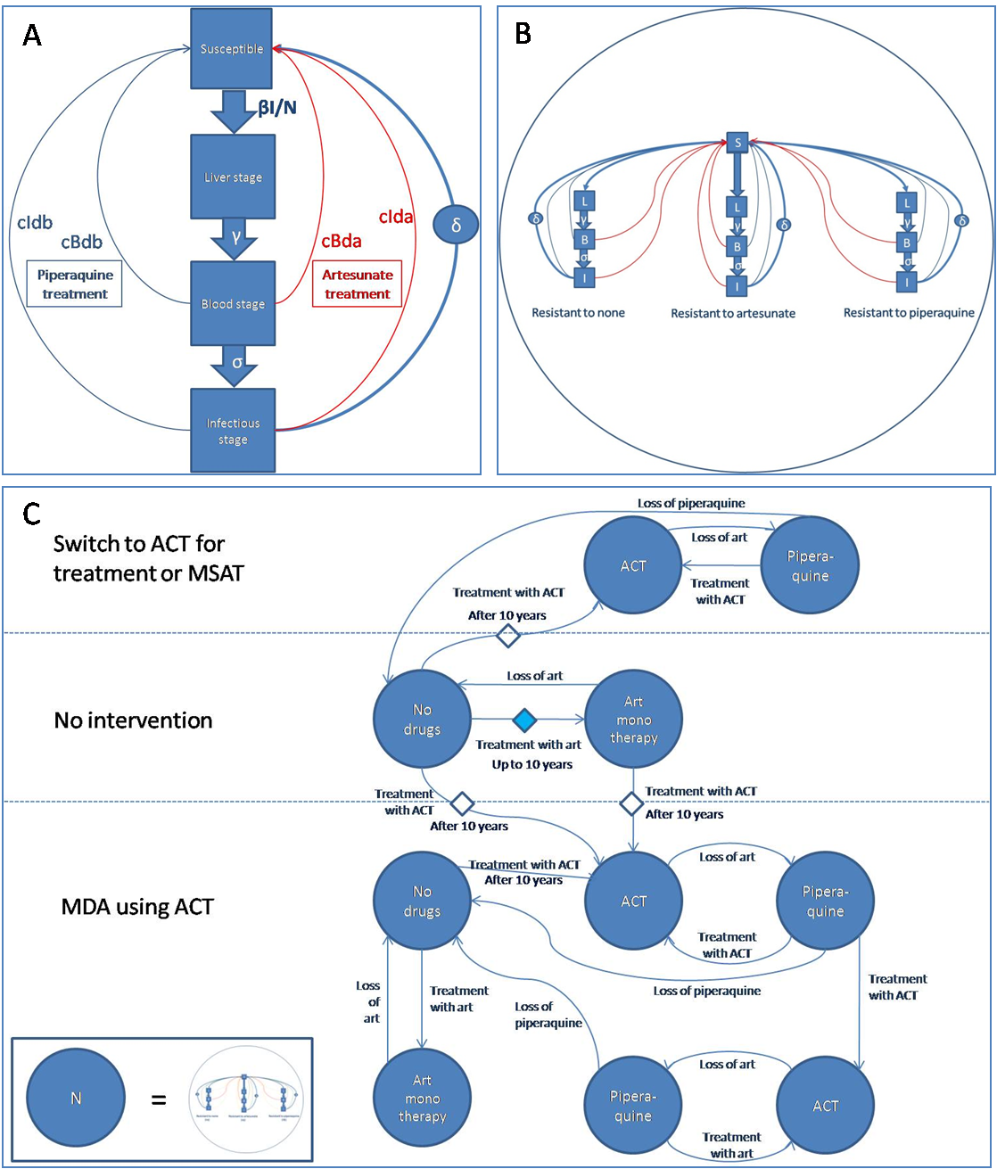

Slide 17
Individual based models
Every single individual in the population is explicitly modelled.
Simulation based – discrete time.
Unit time probabilities of transition between states.
Allows the assignment of a great number of properties to the individuals.

Slide 18
General framework
Time
Properties (e.g)
Each property can easily be coded such that each individual is a collection of numerical variables.
Life history States
Susceptible
Exposed
Infected
Recovered
Home village
Village code
Immunity
Antibody counts or profiles
Clinical immunity
Number of previous exposures
Drug usage
What drugs are in the person’s system
0 | 102 | 0 | 0
3 | 225 | 1 | 1
1 | 203 | 0 | 2
2 | 102 | 0 | 3
Individuals

Slide 19
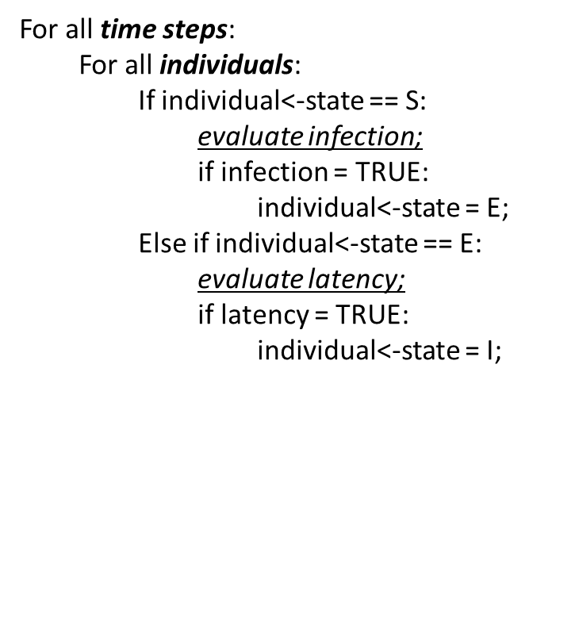
State transition probabilities
S
E
I
R
Infection
Latency
Recovery
Susceptible individuals have a chance of becoming infected given by λ.
Exposed individuals become infectious with probability γ.
Infectious individuals recover with probability μ.

Slide 20
State transition probabilities
evaluate infection???
Assume λ_{t} is the daily probability of acquiring an infection conditional on the number of infectious individuals in the population:
To evaluate whether individual i is infected at time t:
Calculate I_{t-1.}
Draw a random number from a given distribution (let’s assume the uniform distribution for simplicity).
If r < λ_{t} the individual becomes infected and transitions to the exposed state.
vector.test<-c(1,0,0,2,2,1,3)
vector.test
sumI<-length(which(vector.test==2))
sumI
r<-runif(1)
r

Slide 21
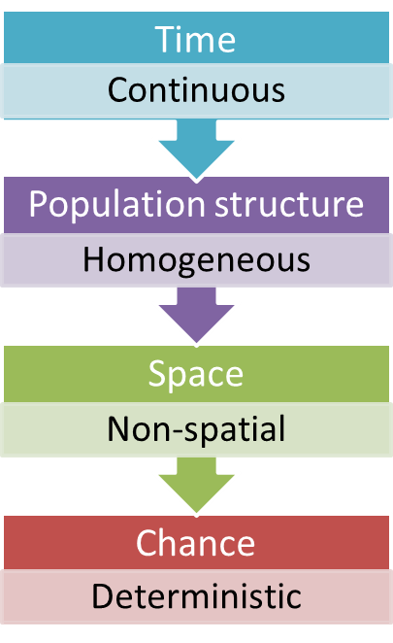
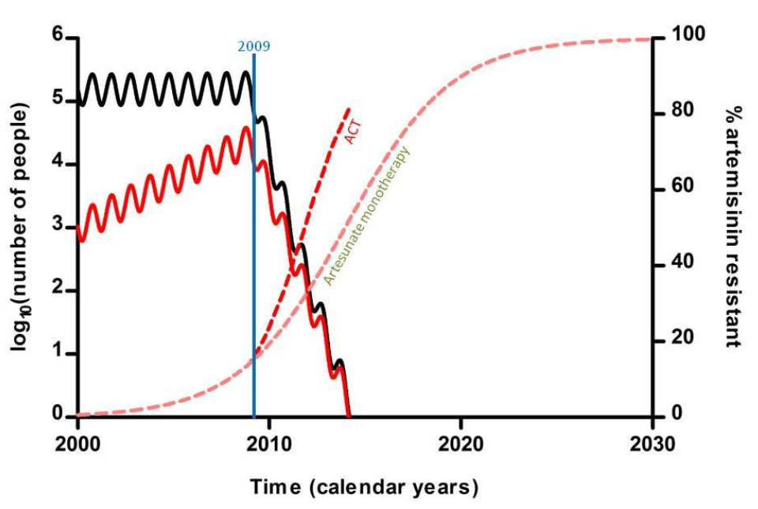
Predicts that elimination of artemisinin resistant malaria using ACT can be achieved only by elimination of all malaria.

Slide 22
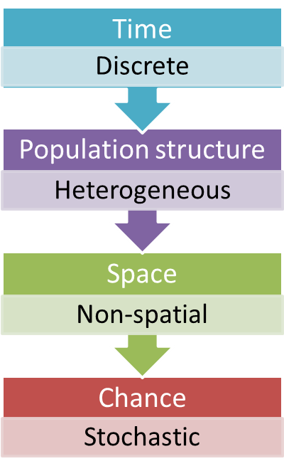
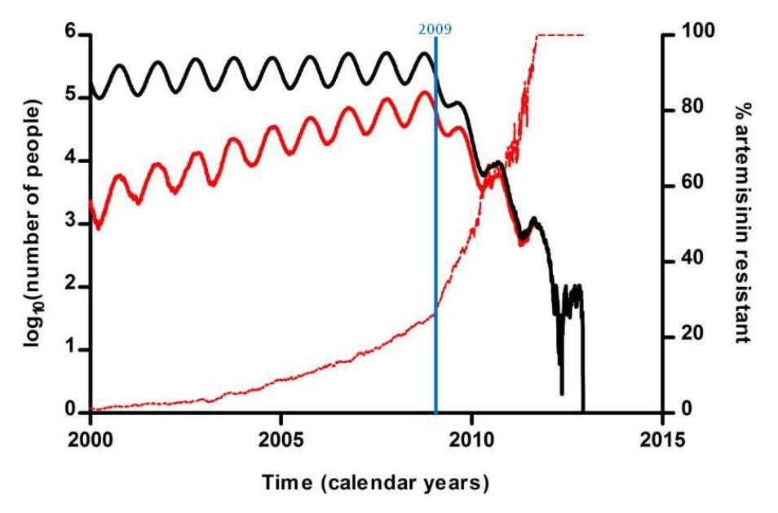

Slide 23
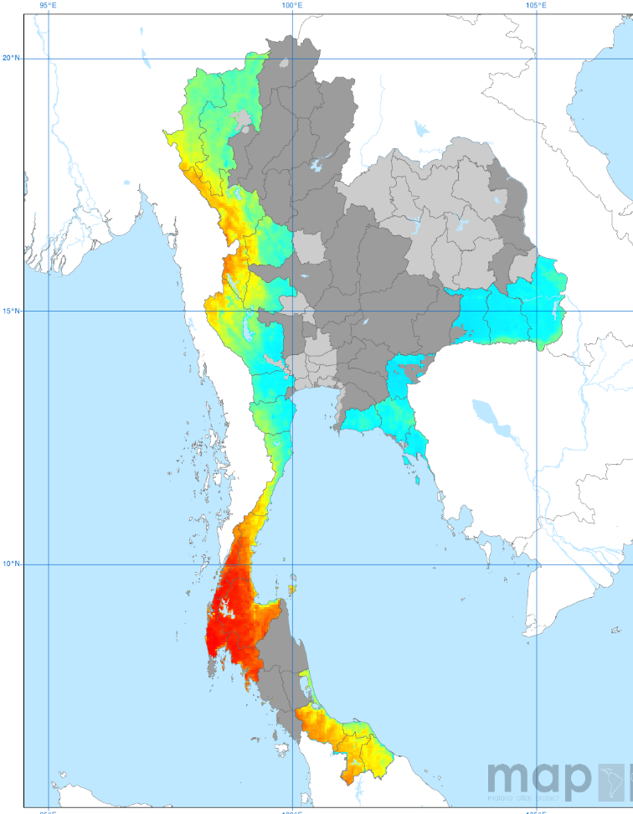

Importance of spatially detailed information

Slide 24
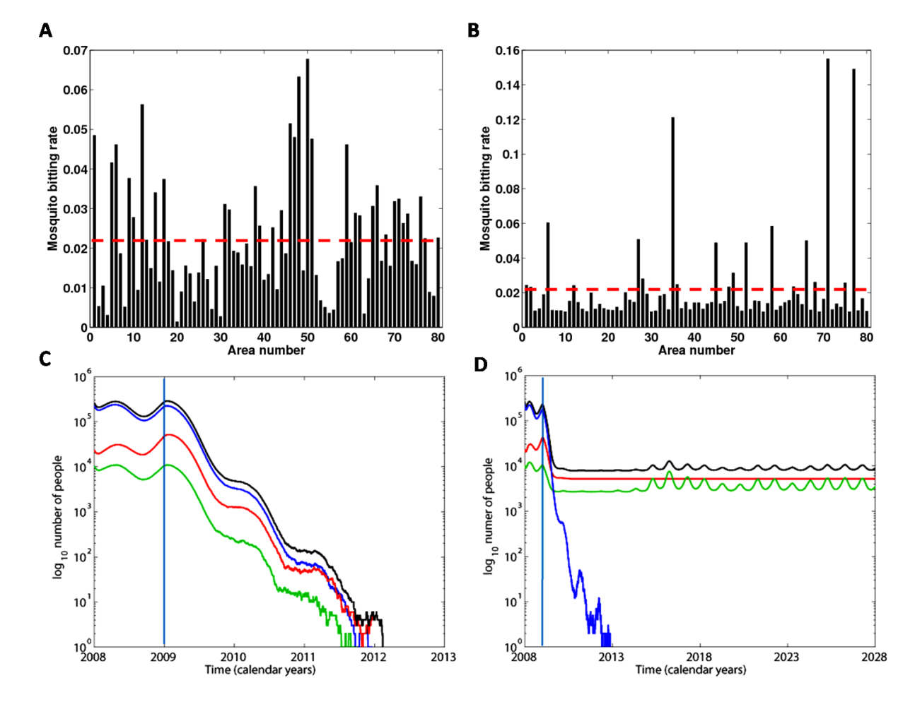
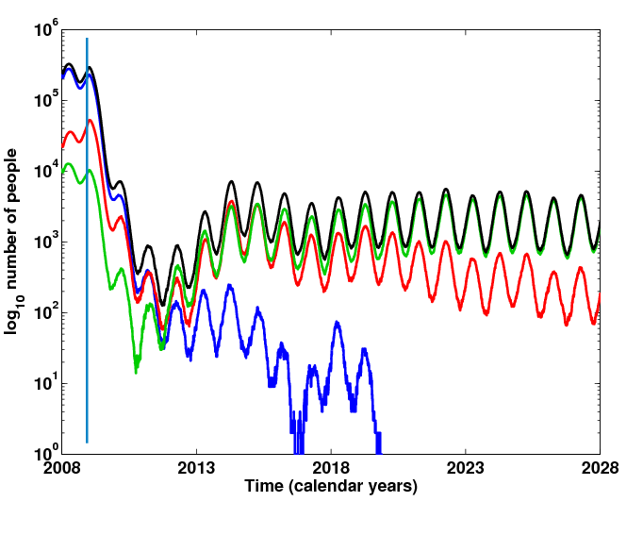

Slide 25
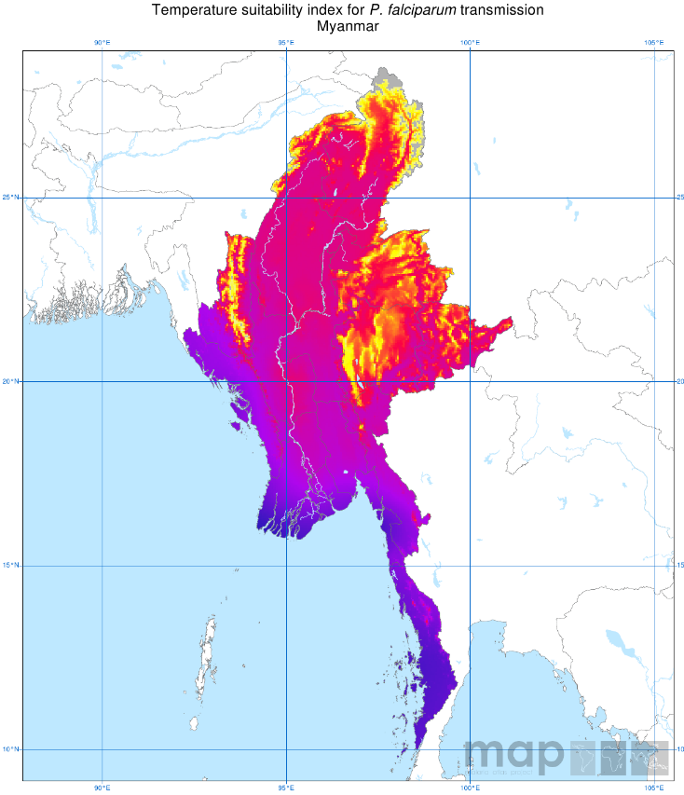
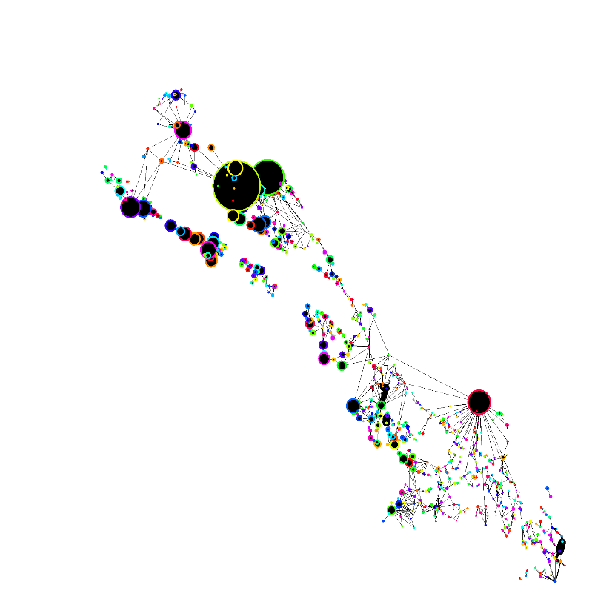
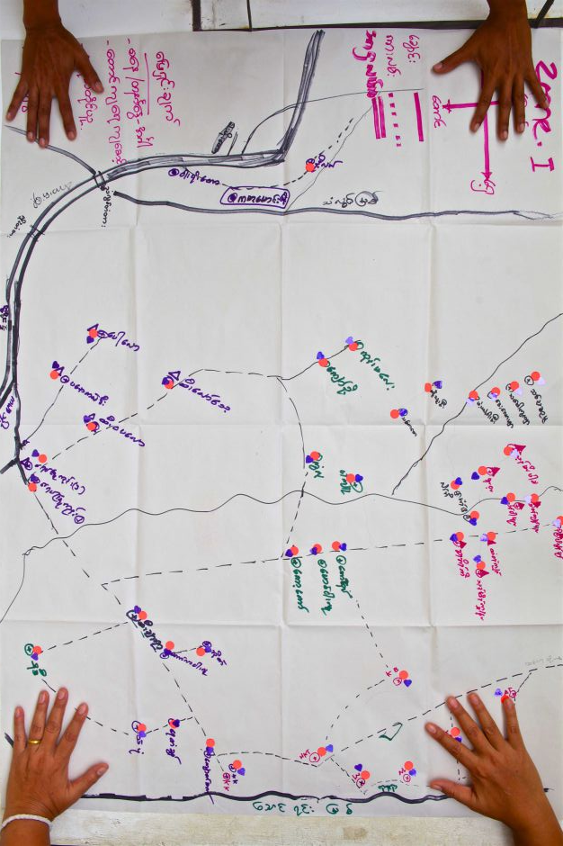
Population Structure/ Mobility
Putting all key elements together
Geographical differences
Logistics

Slide 26
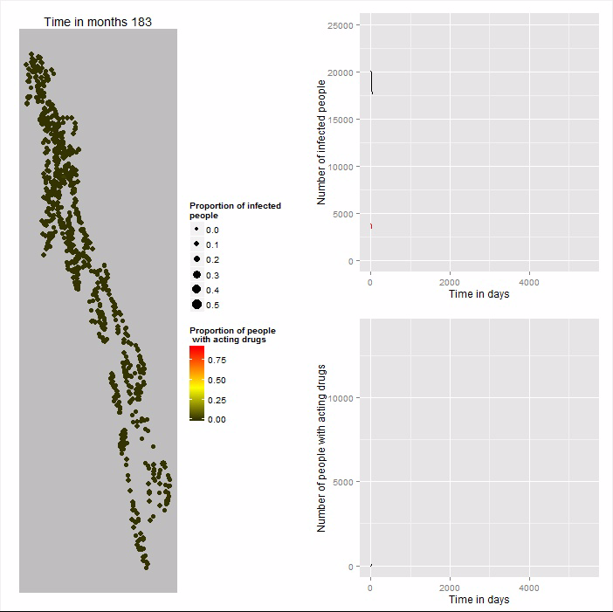

Slide 27
The importance of good clinical case management

Slide 28
